Slide 1

Testing, Azure & Deployment, CI
Testing, Docker, Azure Services, Selenium, Deployment
SoftUni Team
Technical Trainers
Software University
http://softuni.bg

Slide 2
Table of Contents
Testing
Unit Testing
Integration Testing
Selenium
Selenium Integration
Azure
Azure App Service
Azure DevOps
Azure Insights
Docker

Slide 3
Have a Question?
sli.do #csharp-web

Slide 4

Testing
Attention Please!

Slide 5
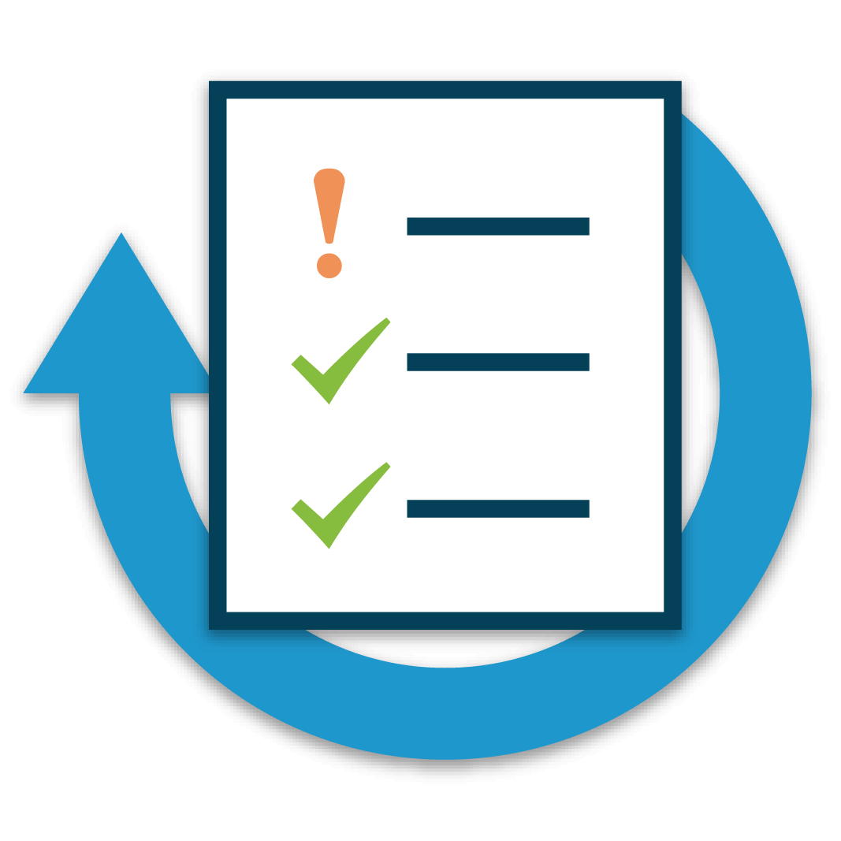
Testing
Testing is an important part of the application lifecycle
In our ever-changing environment, testing is a necessity
New features need to be verified, before delivered to the clients
Testing is a wide area of application development
There are several levels of testing
It does not affect only programmers
It has many concepts of development
There are different types of testing

Slide 6
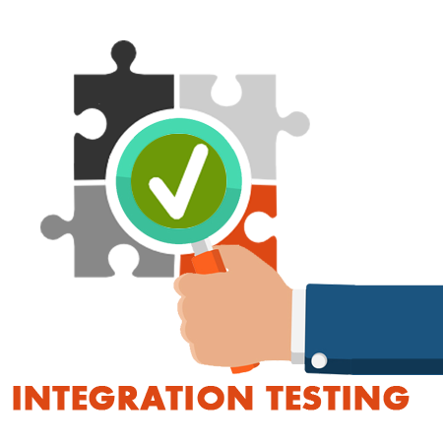
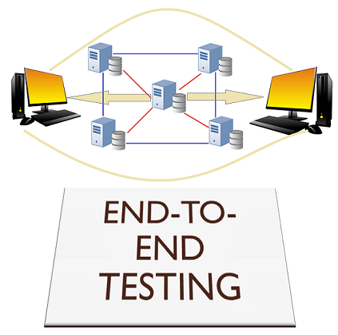
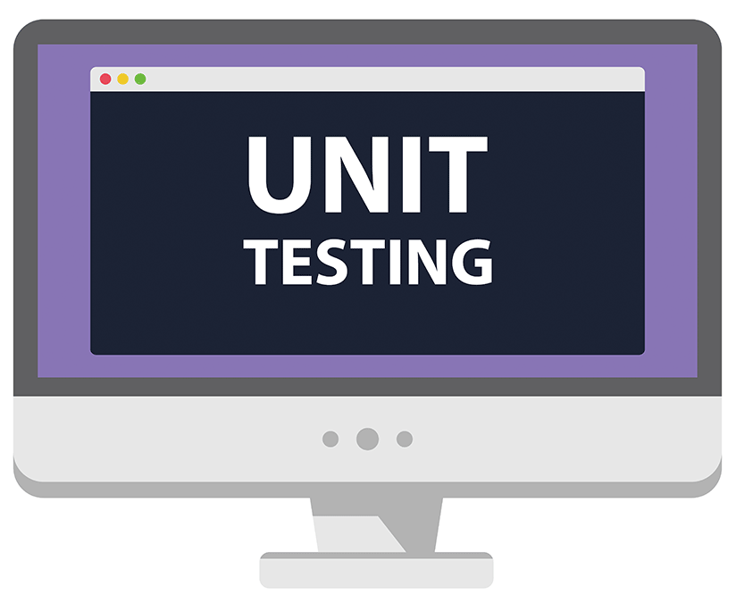
Testing
Web applications also need testing for "unintentional features"
Controllers, Services, Custom Components etc.
Different components of the application are tested differently
They are tested on different levels
Unit testing
Integration testing
End-to-End testing
Every component of the application must be tested

Slide 7
Testing
Some of the most common levels of Software Testing
Testing Level | Description
Unit Testing | Tests Individiual components of code, independent from the infrastructure
Component Testing | Testing of multiple functionalities (a single component)
Integration Testing | Testing of all integrated modules to verify the combined functionality
System Testing | Tests the system as a whole, once all the components are integrated
Regression Testing | Ensures that a fixed bug won't happen again
Acceptance Testing | Tests if the product meets the client’s requirements. Purely done by QAs
Load / Stress Testing | Test the application’s limits by attempting large data processing and introducting abnormal circumstances and conditions (edge cases)
Security Testing | Test if the application has any security flaws and vulnerabilities
Other Types of Testing | Manual, automation, UI, performance, black box, end-to-end testing, etc.

Slide 8
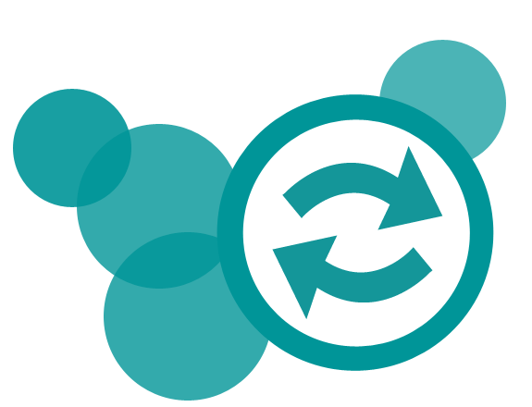
Testing
There are also different concepts and practices of test development
Code-first approach (The usual Development)
Test-first approach (Test-Driven Development)
Each has its own advantages and disadvantages
The Code-first approach ensures flexibility & fast development
The Code-first approach <insert disadvantage here>
The Test-first approach ensures quality and edge case coverage
The Test-first approach is complicated and is an "initial delay"

Slide 9

Unit Testing

Slide 10
Unit Testing
Unit Testing web apps is pretty much like casual unit testing
Writing test methods to test classes and methods (functionalities)
Testing individual code components (units)
Independently from the infrastructure
You still use the same testing frameworks as in casual unit testing
When using a web frameworks such as ASP.NET Core
Built-in logic does not need to be tested
It is already tested during the development of the framework itself
You still need to test your custom functionality

Slide 11
Unit Testing
Mocking – something made as an imitation
Mocking is a software practice, primarily used in Unit Testing
An object under test may have dependencies on other objects
To isolate the behavior, the other objects are replaced
The replacements are mocked objects
The mocked objects simulate the behavior of the real objects
Useful if the real objects are impractical / incorporate to the unit test
Basically, Mocking is creating objects that simulate behavior

Slide 12


Unit Testing
Testing a simple service with mocking in an ASP.NET Core app
public class UserProfile
{
public string Username { get; set; }
public string Password { get; set; }
}
public interface IUserService
{
UserProfile FindUserByUsername(string username);
}
public class UserService : IUserService
{
private readonly IUserRepository userRepository;
public UserService(IUserRepository userRepository)
{
this.userRepository = userRepository;
}
public UserProfile FindUserByUsername(string username)
=> this.userRepository
.GetAllUsers()
.SingleOrDefault(u => u.Username == username);
}
public interface IUserRepository
{
List<UserProfile> GetAllUsers();
}

Slide 13
Unit Testing
Testing a simple service with mocking in an ASP.NET Core app
NOTE: You will need the following NuGet package installed: Moq
public class UserServiceTests
{
public List<UserProfile> GetTestData()
{
return new List<UserProfile>
{
new UserProfile { Username = "Pesho",
Password = "123" },
new UserProfile {
Username = "Ivo",
Password = "Pivo"
}
};
}
... }
public class UserServiceTests
{
...
[Fact]
public void Method_ReturnsCorrect_WhenCorrectIsGiven()
{
var repo = new Mock<IUserRepository>();
repo.Setup(r => r.GetAllUsers())
.Returns(GetTestData());
IUserService service = new UserService(repo.Object);
UserProfile user = service.FindUserByUsername("Pesho");
Assert.True(user.Username == "Pesho", "Broken...");
Assert.True(user.Password == "123", "Broken...");
}
}
The testing is performed, using xUnit testing framework

Slide 14
In-memory Database
Services, accessing a Database, can (and should) also be tested
When testing such Services, you don’t create a new Database
This would, otherwise, overload the Database Server
When testing such Service, you use In-Memory Database
EF Core provides an In-Memory Database
Included with the Microsoft.EntityFrameworkCore.InMemory package
The In-Memory is non-relational, and it doesn’t have to be
The In-Memory database’s general purpose is to be a testing database

Slide 15
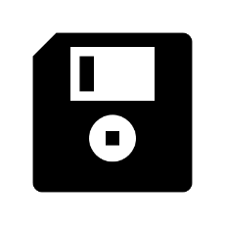
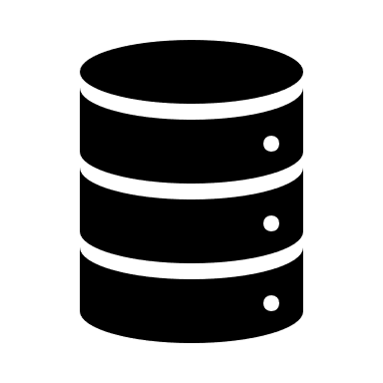


In-memory Database
Using EF Core’s In-Memory Database in Unit Tests
public class UserProfile
{
public string Id { get; set; }
public string Username { get; set; }
public string Password { get; set; }
}
public class AppDbContext : DbContext
{
public AppDbContext(DbContextOptions<AppDbContext> options) : base(options) { }
public DbSet<UserProfile> UserProfiles { get; set; }
}
public class UserService : IUserService
{
private readonly AppDbContext appDbContext;
public UserService(AppDbContext appDbContext)
{
this.appDbContext = appDbContext;
}
public UserProfile FindUserByUsername(string username)
=> this.appDbContext.UserProfiles.SingleOrDefault(u => u.Username == username);
}

Slide 16
In-memory Database
Using EF Core’s In-Memory Database in Unit Tests
public class UserServiceTests
{
...
[Fact]
public void Method_ReturnsCorrect_WhenCorrectIsGiven()
{
var options = new DbContextOptionsBuilder<AppDbContext>()
.UseInMemoryDatabase(databaseName: "Find_User_Database") // Give a Unique name to the DB
.Options;
using (var dbContext = new AppDbContext(options)) // Initialize Testing Data
{
dbContext.UserProfiles.AddRange(GetTestData());
dbContext.SaveChanges();
}
UserProfile user = null;
...
}
}

Slide 17
In-memory Database
Using EF Core’s In-Memory Database in Unit Tests
public class UserServiceTests
{
...
[Fact]
public void Method_ReturnsCorrect_WhenCorrectIsGiven()
{
...
using (var dbContext = new AppDbContext(options)) // Initialize Context again
{
IUserService service = new UserService(dbContext); // Pass it to Service as dependency
user = service.FindUserByUsername("Pesho"); // Find the User
}
Assert.True(user != null, "Broken..."); // Check if the User is null (we set it to null initially)
Assert.True(user.Username == "Pesho", "Broken...");
Assert.True(user.Password == "123", "Broken...");
}
}

Slide 18
Integration Testing

Slide 19
Integration Testing
Integration Testing ensures app components:
Function correctly at the level of the infrastructure
Database, File System, Network, Pipelines etc.
Work together correctly to produce expected results
Integration Tests are far more complicated than Unit Tests
Use actual components, rather than mocked such
Require more code and data processing
Take longer time develop, run and process

Slide 20
Integration Testing
ASP.NET Core supports Integration Testing using a Unit Test framework
The framework has an integrated web host and in-memory test server
Integration Tests follow a sequence of events
The app’s web host must be configured
A test server client is created to submit requests to the app
[Arrange] The test app prepares a request
[Act] The client submits the request and receives a response
[Assert] The actual response is validated based on expected result
After all tests have run, the results are reported

Slide 21
Integration Testing
public class IntegrationTest : IClassFixture<WebApplicationFactory<Startup>>
{
private readonly WebApplicationFactory<Startup> factory;
public IntegrationTest(WebApplicationFactory<Startup> factory)
{
this.factory = factory;
}
...
}
IClassFixture interface indicates the class contains tests and provides shared object instances across tests in the class
TEntryPoint is the entry point of the Tested App. Usually that is the Startup.cs
WebApplicationFactory<TEntryPoint> is used to create a TestServer
public class IntegrationTest : IClassFixture<WebApplicationFactory<Startup>>
{
...
[Theory]
[InlineData("/")]
[InlineData("/About")]
[InlineData("/Contacts")]
public async Task Test_EndpointReturnSuccessAndCorrectContentType(string url) { ... }
}
NOTE: You will need the following NuGet package installed
Microsoft.AspNetCore.Mvc.Testing
Used to parameterize a test
Used to pass parameters to the test

Slide 22
Integration Testing
This integration test, simply tests response status code and content type
public class IntegrationTest : IClassFixture<WebApplicationFactory<Startup>>
{
...
[Theory]
[InlineData("/")]
[InlineData("/About")]
[InlineData("/Contacts")]
public async Task Test_EndpointReturnSuccessAndCorrectContentType(string url)
{
//Arrange
var client = this.factory.CreateClient(); // Creates a HttpClient
//Act
var response = await client.GetAsync(url); // Simulates a Get Request to the given URL
//Assert
response.EnsureSuccessStatusCode(); // 200 - 299 (SUCCESS)
Assert.Equal("text/html; charset=utf-8", response.Content.Headers.ContentType.ToString());
}
}
NOTE: You will need the following NuGet package installed
Microsoft.AspNetCore.App

Slide 23
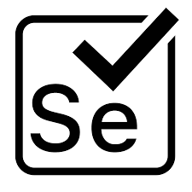
Selenium

Slide 24

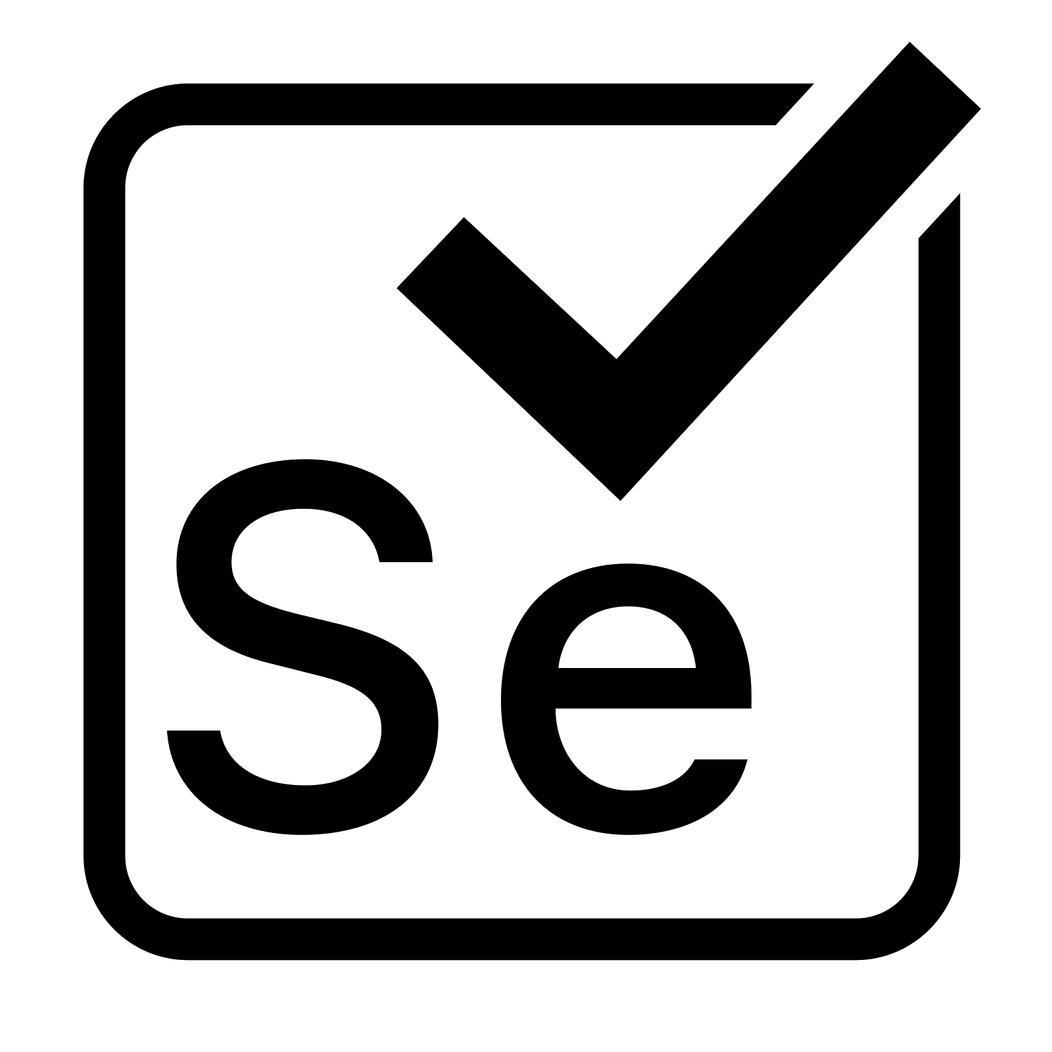
Selenium
Selenium is a portable testing framework for web applications
Provides a playback tool for authoring tests (Selenium IDE)
Provides a test domain-specific language (Selenese)
Provides "browser driving" natively (Selenium WebDriver)
"Selenium automates browsers. That’s it!" ~ Selenium docs
Automates web applications for test purposes
Useful for integration testing SPA apps

Slide 25
Selenium
Let’s see how Selenium is used in ASP.NET Core App Testing
npm install –g selenium-standalone
Install the npm package
You will also need the NuGet Packages Selenium.Support, Selenium.WebDriver
public class SeleniumServerFactory<TStartup>
: WebApplicationFactory<Startup> where TStartup : class
{
private Process process;
private IWebHost host;
public SeleniumServerFactory() { ... }
public string RootUri { get; set; } //Save this use by tests
protected override TestServer CreateServer(IWebHostBuilder builder) { ... }
protected override void Dispose(bool disposing) { ... }
}

Slide 26
Selenium
Let’s see how Selenium is used in ASP.NET Core App Testing
public class SeleniumServerFactory<TStartup>
: WebApplicationFactory<Startup> where TStartup : class
{
...
public SeleniumServerFactory()
{
ClientOptions.BaseAddress = new Uri("https://localhost"); //will follow redirects by default
this.process = new Process() {
StartInfo = new ProcessStartInfo {
FileName = "selenium-standalone",
Arguments = "start",
UseShellExecute = true
}
};
this.process.Start();
}
...
}

Slide 27
Selenium
Let’s see how Selenium is used in ASP.NET Core App Testing
public class SeleniumServerFactory<TStartup>
: WebApplicationFactory<Startup> where TStartup : class
{
...
protected override TestServer CreateServer(IWebHostBuilder builder)
{
//Real TCP port
this.host = builder.Build();
this.host.Start();
//Last is https://localhost:5001!
this.RootUri = this.host.ServerFeatures.Get<IServerAddressesFeature>().Addresses.LastOrDefault();
//Fake Server we won't use...this is lame. Should be cleaner, or a utility class
return new TestServer(new WebHostBuilder().UseStartup<TStartup>());
}
...
}

Slide 28
Selenium
Let’s see how Selenium is used in ASP.NET Core App Testing
We are just getting started, this is only the factory.
public class SeleniumServerFactory<TStartup>
: WebApplicationFactory<Startup> where TStartup : class
{
...
protected override void Dispose(bool disposing)
{
base.Dispose(disposing);
if (disposing) {
this.host.Dispose();
this.process.CloseMainWindow(); //Be sure to stop Selenium Standalone
}
}
}

Slide 29
Selenium
public class SeleniumTests : IClassFixture<SeleniumServerFactory<Startup>>, IDisposable
{
public SeleniumServerFactory<Startup> Server { get; }
public IWebDriver Browser { get; }
public HttpClient Client { get; }
public ILogs Logs { get; }
public SeleniumTests(SeleniumServerFactory<Startup> server)
{
this.Server = server;
this.Client = server.CreateClient(); // This call shouldn't be required for setup, but it is. (weird)
var opts = new ChromeOptions();
opts.AddArgument("--headless"); //Optional, comment this out if you want to SEE the browser window
opts.SetLoggingPreference(OpenQA.Selenium.LogType.Browser, LogLevel.All);
var driver = new RemoteWebDriver(opts);
this.Browser = driver;
this.Logs = new RemoteLogs(driver);
}
...
}

Slide 30
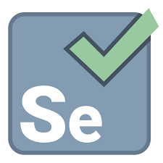

Selenium
And now that the configuration is done, let’s see some tests
public class SeleniumTests
: IClassFixture<SeleniumServerFactory<Startup>>
, IDisposable
{
...
[Fact]
public void LoadTheMainPageAndCheckTitle()
{
Browser.Navigate().GoToUrl(Server.RootUri);
Assert.StartsWith("Sample", Browser.Title);
}
...
}
public class SeleniumTests
: IClassFixture<SeleniumServerFactory<Startup>>
, IDisposable
{
...
[Fact]
public void ThereIsAnH1()
{
Browser.Navigate().GoToUrl(Server.RootUri);
var headerSelector = By.TagName("h1");
Assert.Equal("Heading", Browser.FindElement(headerSelector).Text);
}
...
}

Slide 31

[Fact]
public void IndexRandomJokesAre20()
{
this.Browser.Navigate().GoToUrl(this.Server.RootUri);
var jokesSelector = By.ClassName("clearfix");
Assert.Equal(20, this.Browser.FindElements(jokesSelector).Count);
}
Selenium Testing
Jokes App - Live Demonstration

Slide 32
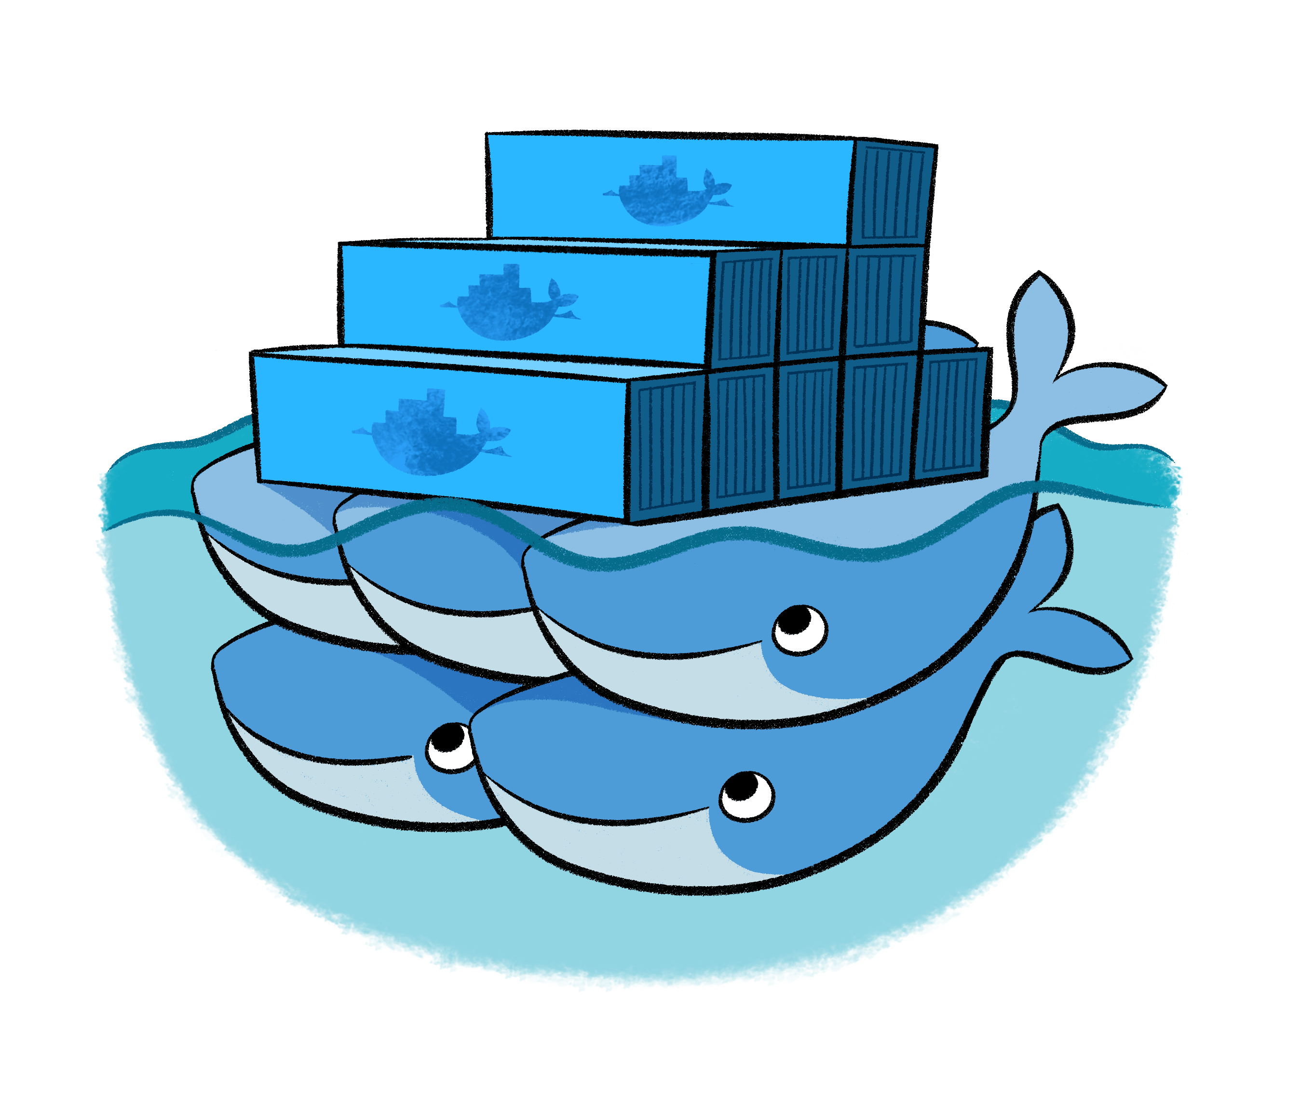
Docker

Slide 33
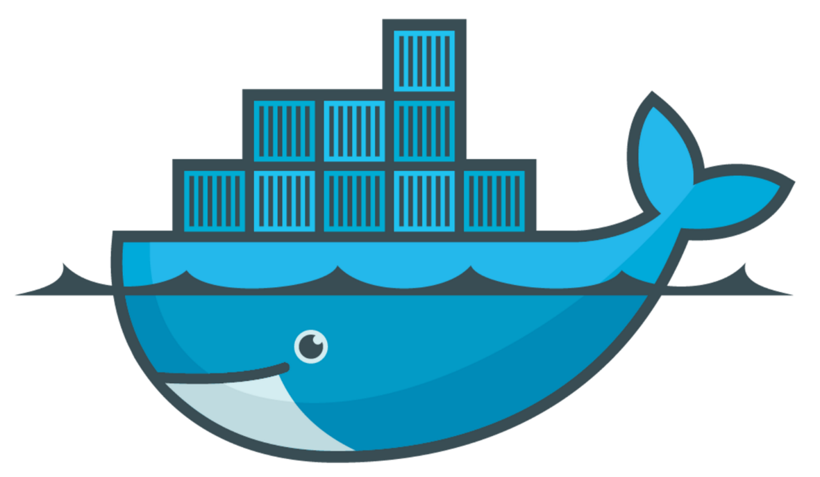
Docker
Docker is a software that performs operating-system-level virtualization
The process is also known as "containerization"
Docker runs software packages called "containers"
Containers are isolated from each other
Each bundles its own application, tools, libraries, configuration files etc.
They can communicate with each other through well-defined channels
All containers are run by a single Operating System
This makes them significantly more lightweight than virtual machines
Containers are created by "images" that specify their contents

Slide 34
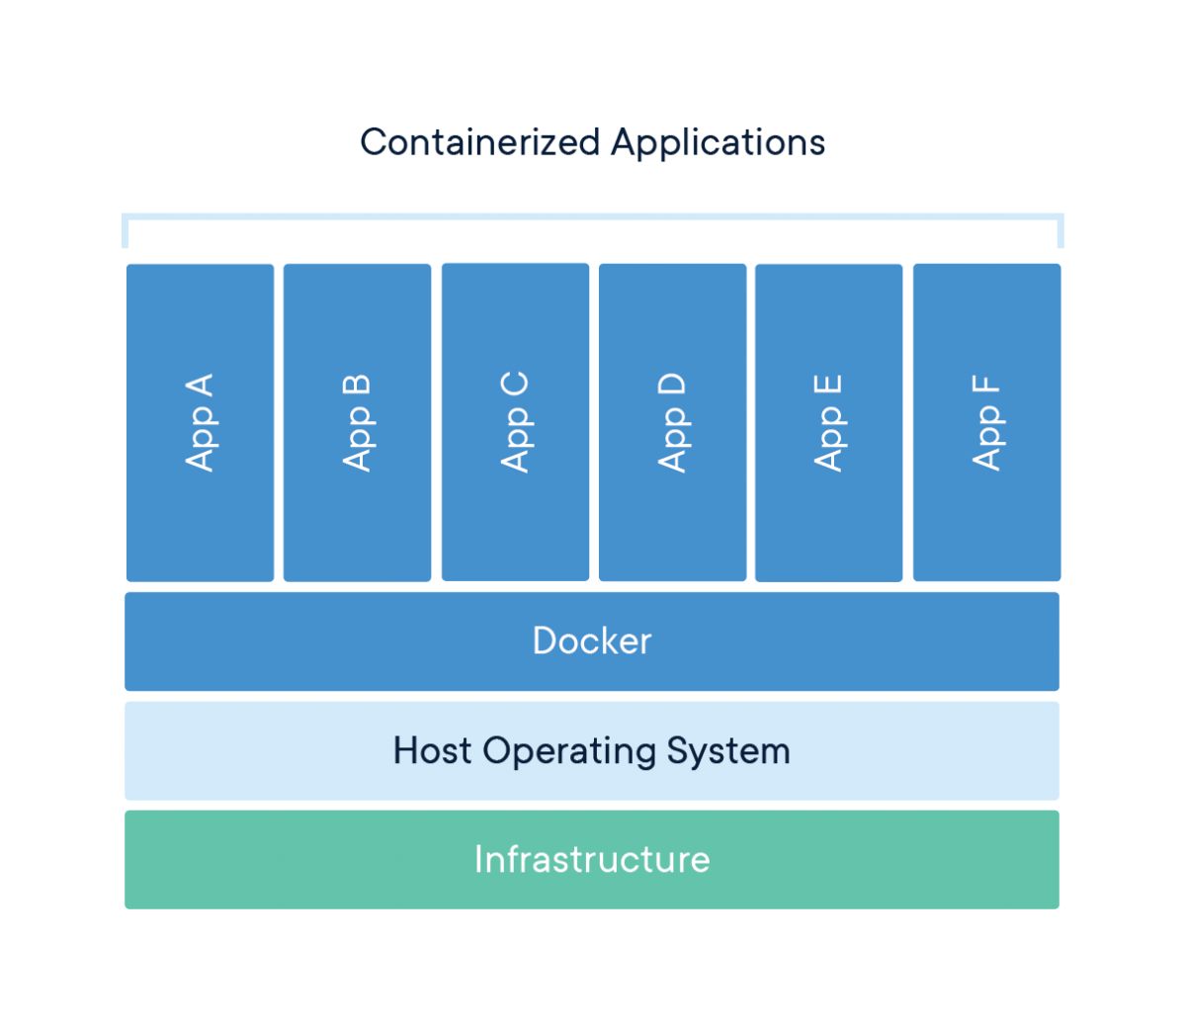


Docker

Slide 35
Docker Container
Containers are standard units of software
Each packages up code and dependencies to improve the app
Images are lightweight, standalone, executable packages of software
Containers Images become containers at runtime
In Docker, they become containers when ran on Docker Engine
Always runs the same way, regardless of the Operating System
Containers that run on the Docker Engine include:
Standard Containers, Lightweight Containers, Secure Containers

Slide 36
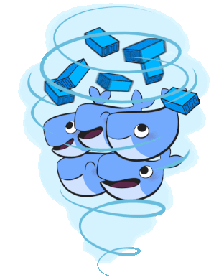

Dockerizing ASP.NET Core
Live Demonstration

Slide 37

Microsoft Azure

Slide 38
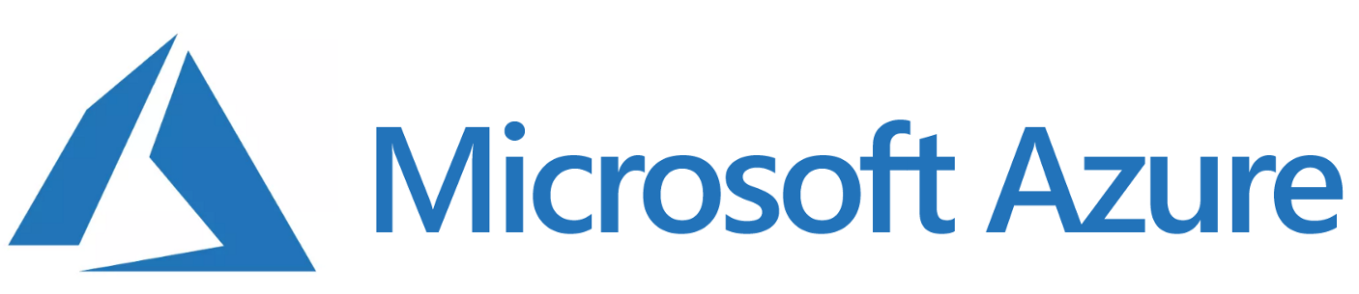
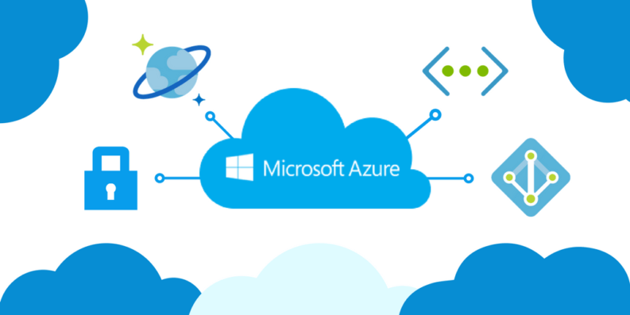
Azure
Microsoft Azure is a cloud-computing service
Designed for building, testing, deploying and managing apps
Applications and services are managed through a global network
Microsoft Azure provides and supports
Software-as-a-Service (SaaS)
Platform-as-a-Service (PaaS)
Infrastructure-as-a-Service (IaaS)
Many different languages, tools and frameworks

Slide 39
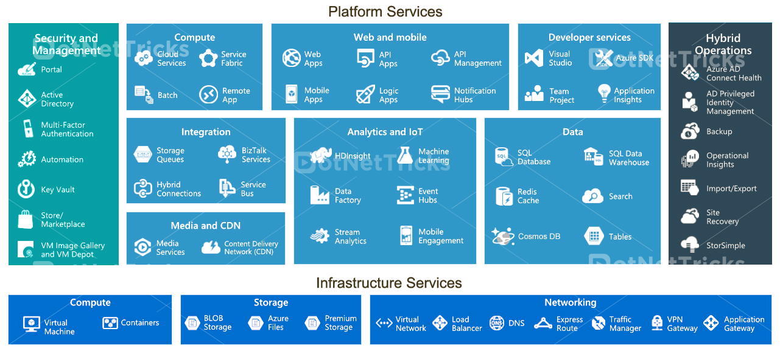


Azure
Some of the most important Microsoft Azure Services include:
Mobile Services
Storage Services
Data Management
Messaging
CDN
Developer
Application Insights
Azure DevOps

Slide 40
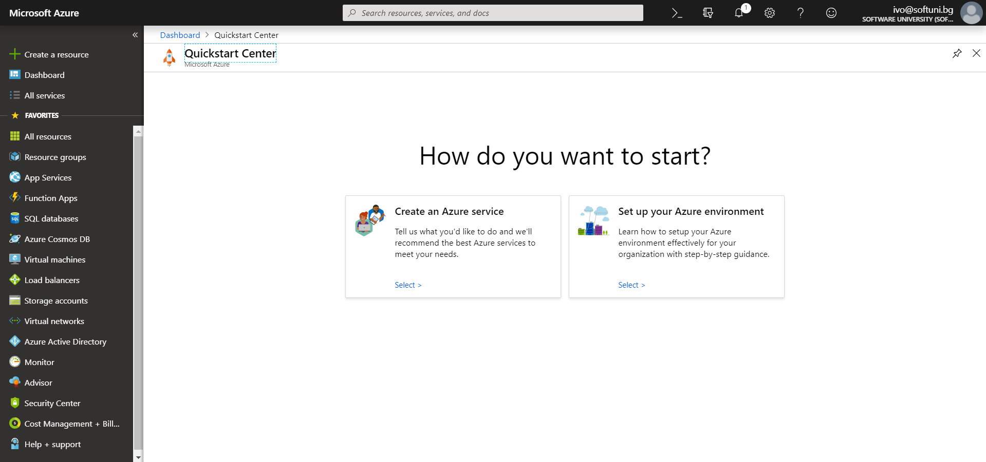
Azure Portal Demonstration

Slide 41

Application Insights
Application Insights is an extensible APM service for web developers
Application Performance Management
Used to monitor live web applications
Automatically detects performance anomalies
Application Insights includes
Powerful analytics tools for diagnostics
Analytics over client usage on the app
Designed to help with improvement of performance and usability

Slide 42
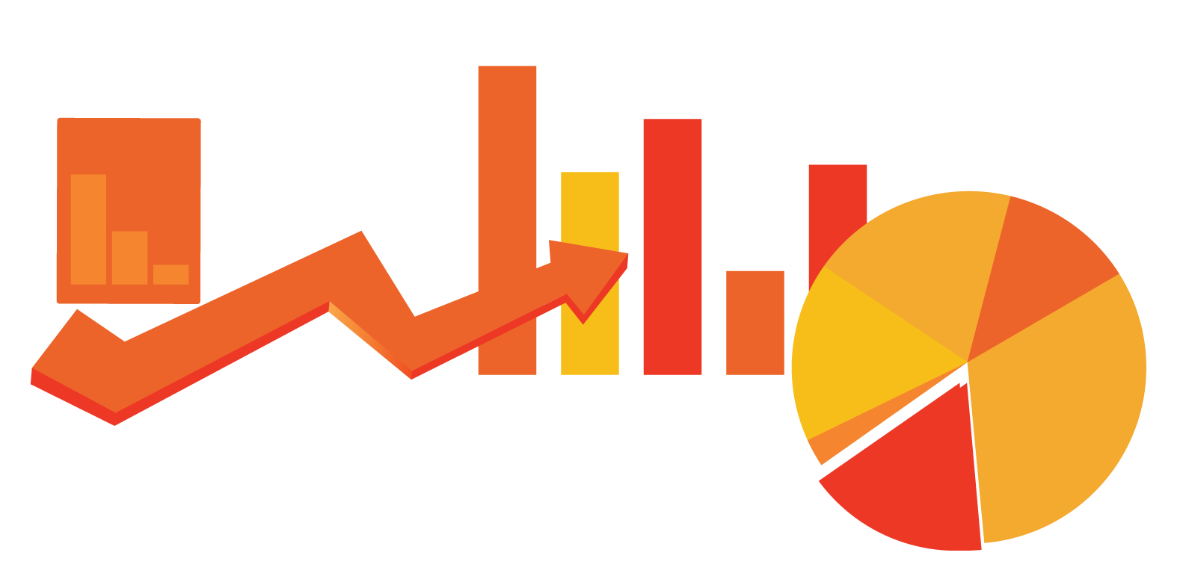
Application Insights
Application Insights Installation is quite simple
You install a small instrumentation package in your app
You setup an Application Insights resource in the Azure portal
The instrumentation monitors your app and sends telemetry data
Data is sent directly to the Azure portal
The application can run anywhere
It doesn’t have to be hosted on Azure
Aside from the web services, you can instrument other components

Slide 43
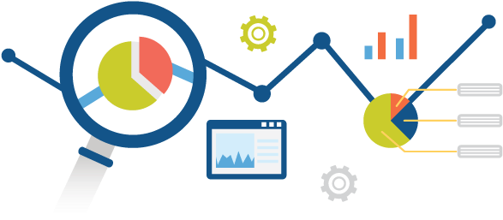
Application Insights
Application Insights monitors several essential things
Request rates, Response times, Failure rates
Dependency rates, Exceptions, AJAX calls
Page views and load performance
User and session counts, Performance counters
Host diagnostics, Diagnostic trace logs
Custom events and metrics

Slide 44

Application Insights
Live Demonstration

Slide 45

Azure DevOps
DevOps – Development & Operations
Software Development Mythology
DevOps combines
Software Development (Dev) and Technology Operations (Ops)
DevOps aims to optimize the systems development lifecycle
Unifies processes such as code, build, test, deliver, monitor etc.
DevOps Engineers are treated as the "Special Forces" of a company
Basically, If you are a DevOps Engineer, you do all the stuff...

Slide 46






Azure DevOps
Azure DevOps is a set of tools and services for DevOps
Azure Boards
Azure Pipelines
Azure Repos
Azure Test Plans
Azure Artifacts
Extensions Marketplace
A catalog of Azure DevOps extensions

Slide 47
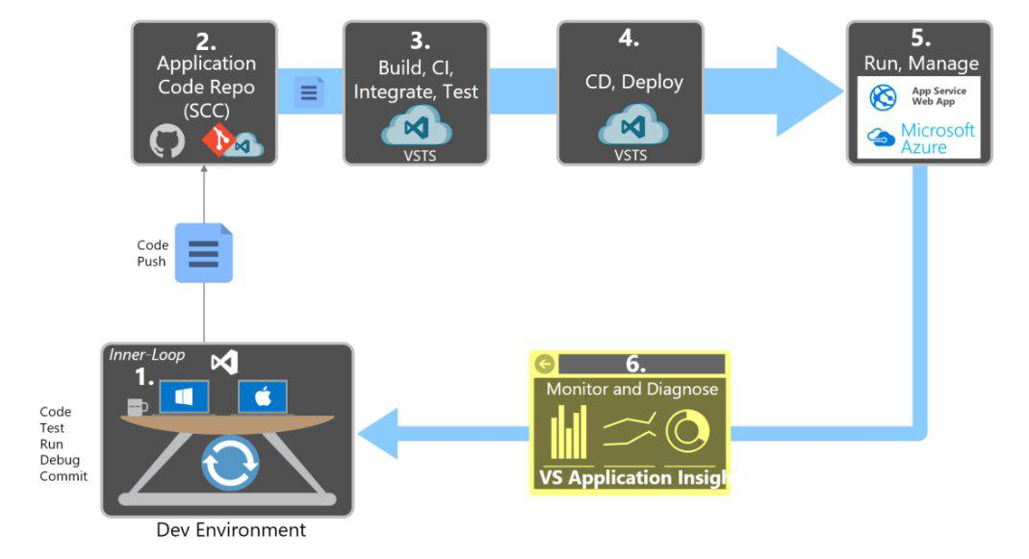
Azure DevOps

Slide 48
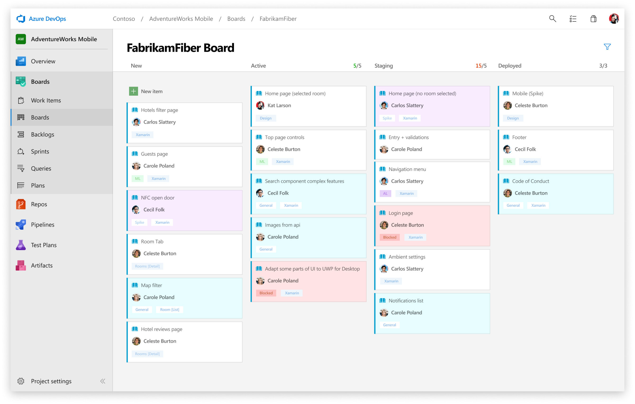
Azure Boards
Plan, track, and discuss work across your teams

Slide 49

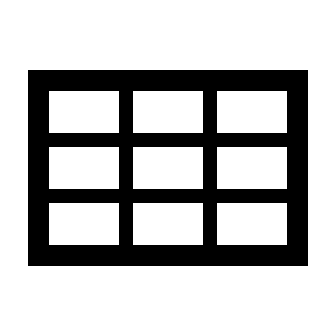
Azure Boards
Azure Boards is a set of tools for Agile Development
Kanban Boards, backlogs, team dashboards, custom reporting
Drag-and-Drop sprint planning, Flexible work item tracking
Azure Boards is extremely convenient and widely used
Customizable dashboards, workflows, boards...
Scrum ready, Built for insights
Absolutely free for Open-source projects and small teams

Slide 50
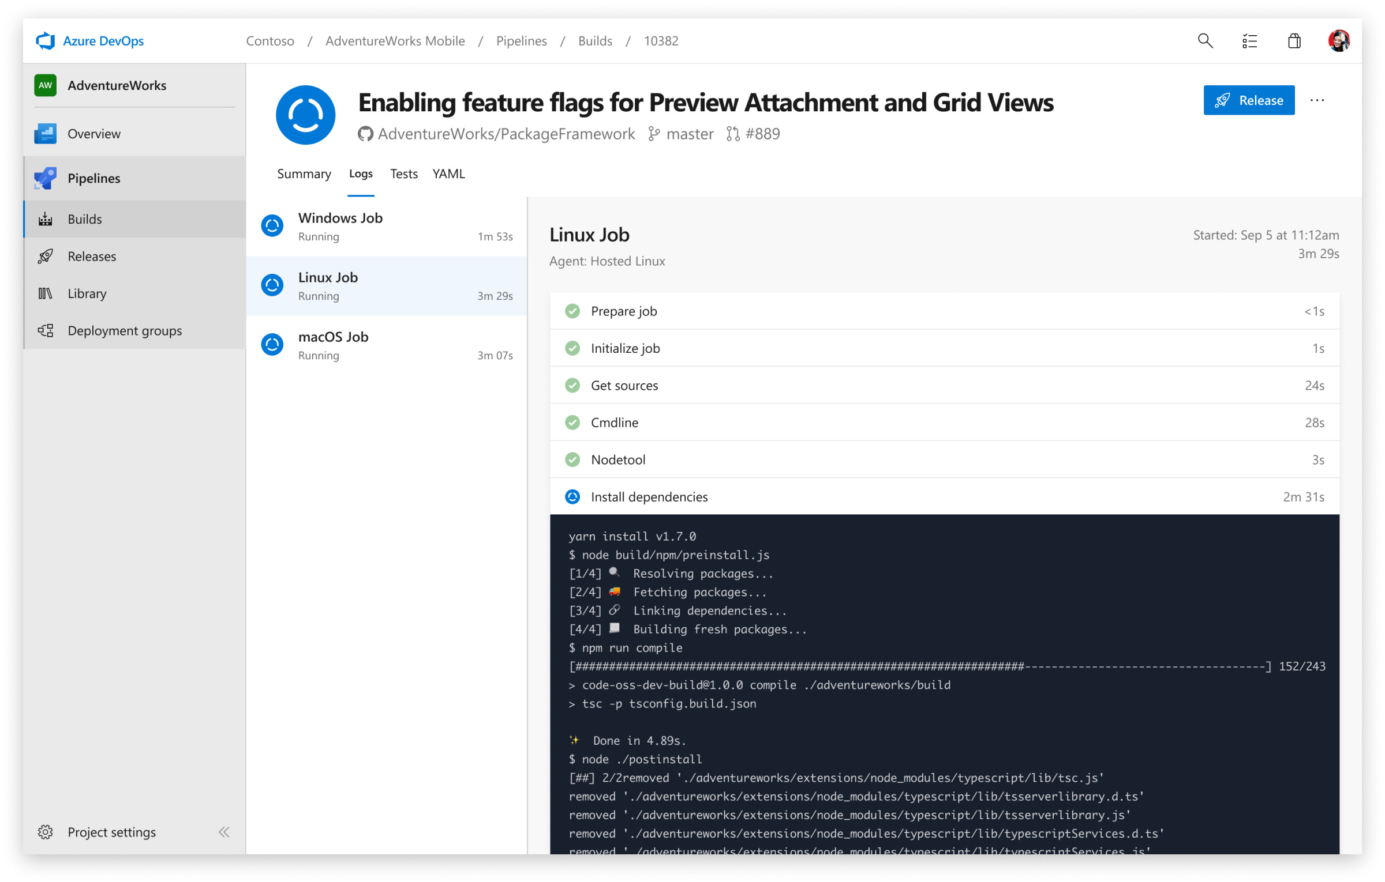
Azure Pipelines
Continuously build, test, and deploy

Slide 51
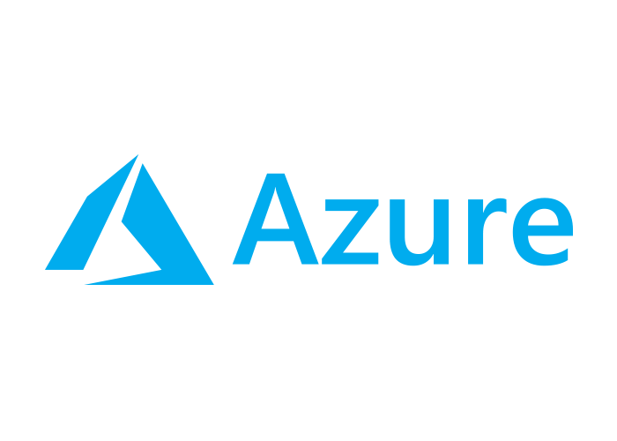
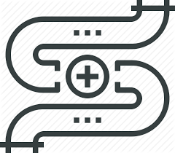
Azure Pipelines
Azure Pipelines is a set of tools for building, testing & deployment
Cloud-hosted pipelines for Linux, macOS and Windows
Unlimited time + 10 free parallel jobs for Open Source projects
Azure Pipelines automates build and deployment processes
Optimizing your time with the "nuts & bolts"
Any language, any platform. Deploy to any cloud
Containers & Kubernetes. Best-in-class for Open Source
Extensible. Advanced Workflows and Features

Slide 52
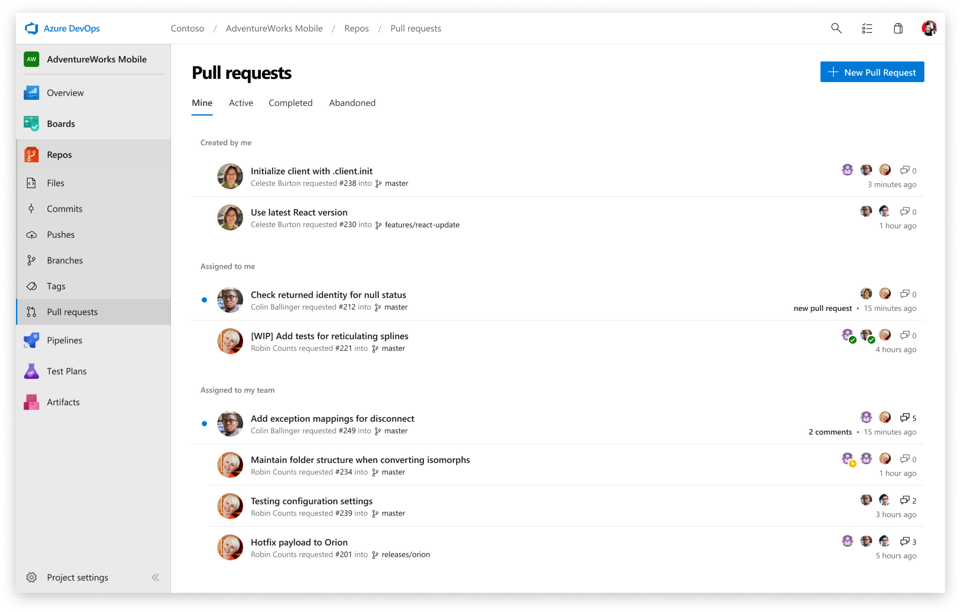
Azure Repos
Get unlimited, cloud-hosted private Git repos

Slide 53


Azure Repos
Azure Repos – free private Git repositories, pull requests etc
Unlimited private Git repositories hosting and support
Designed for TFVC
Azure Repos provides
Support for any Git client, Automation with built-in CI / CD
Web hooks & API integration, Branching policies
Semantic code search, code reviews, threaded discussions
Absolutely free for open source projects and small teams

Slide 54
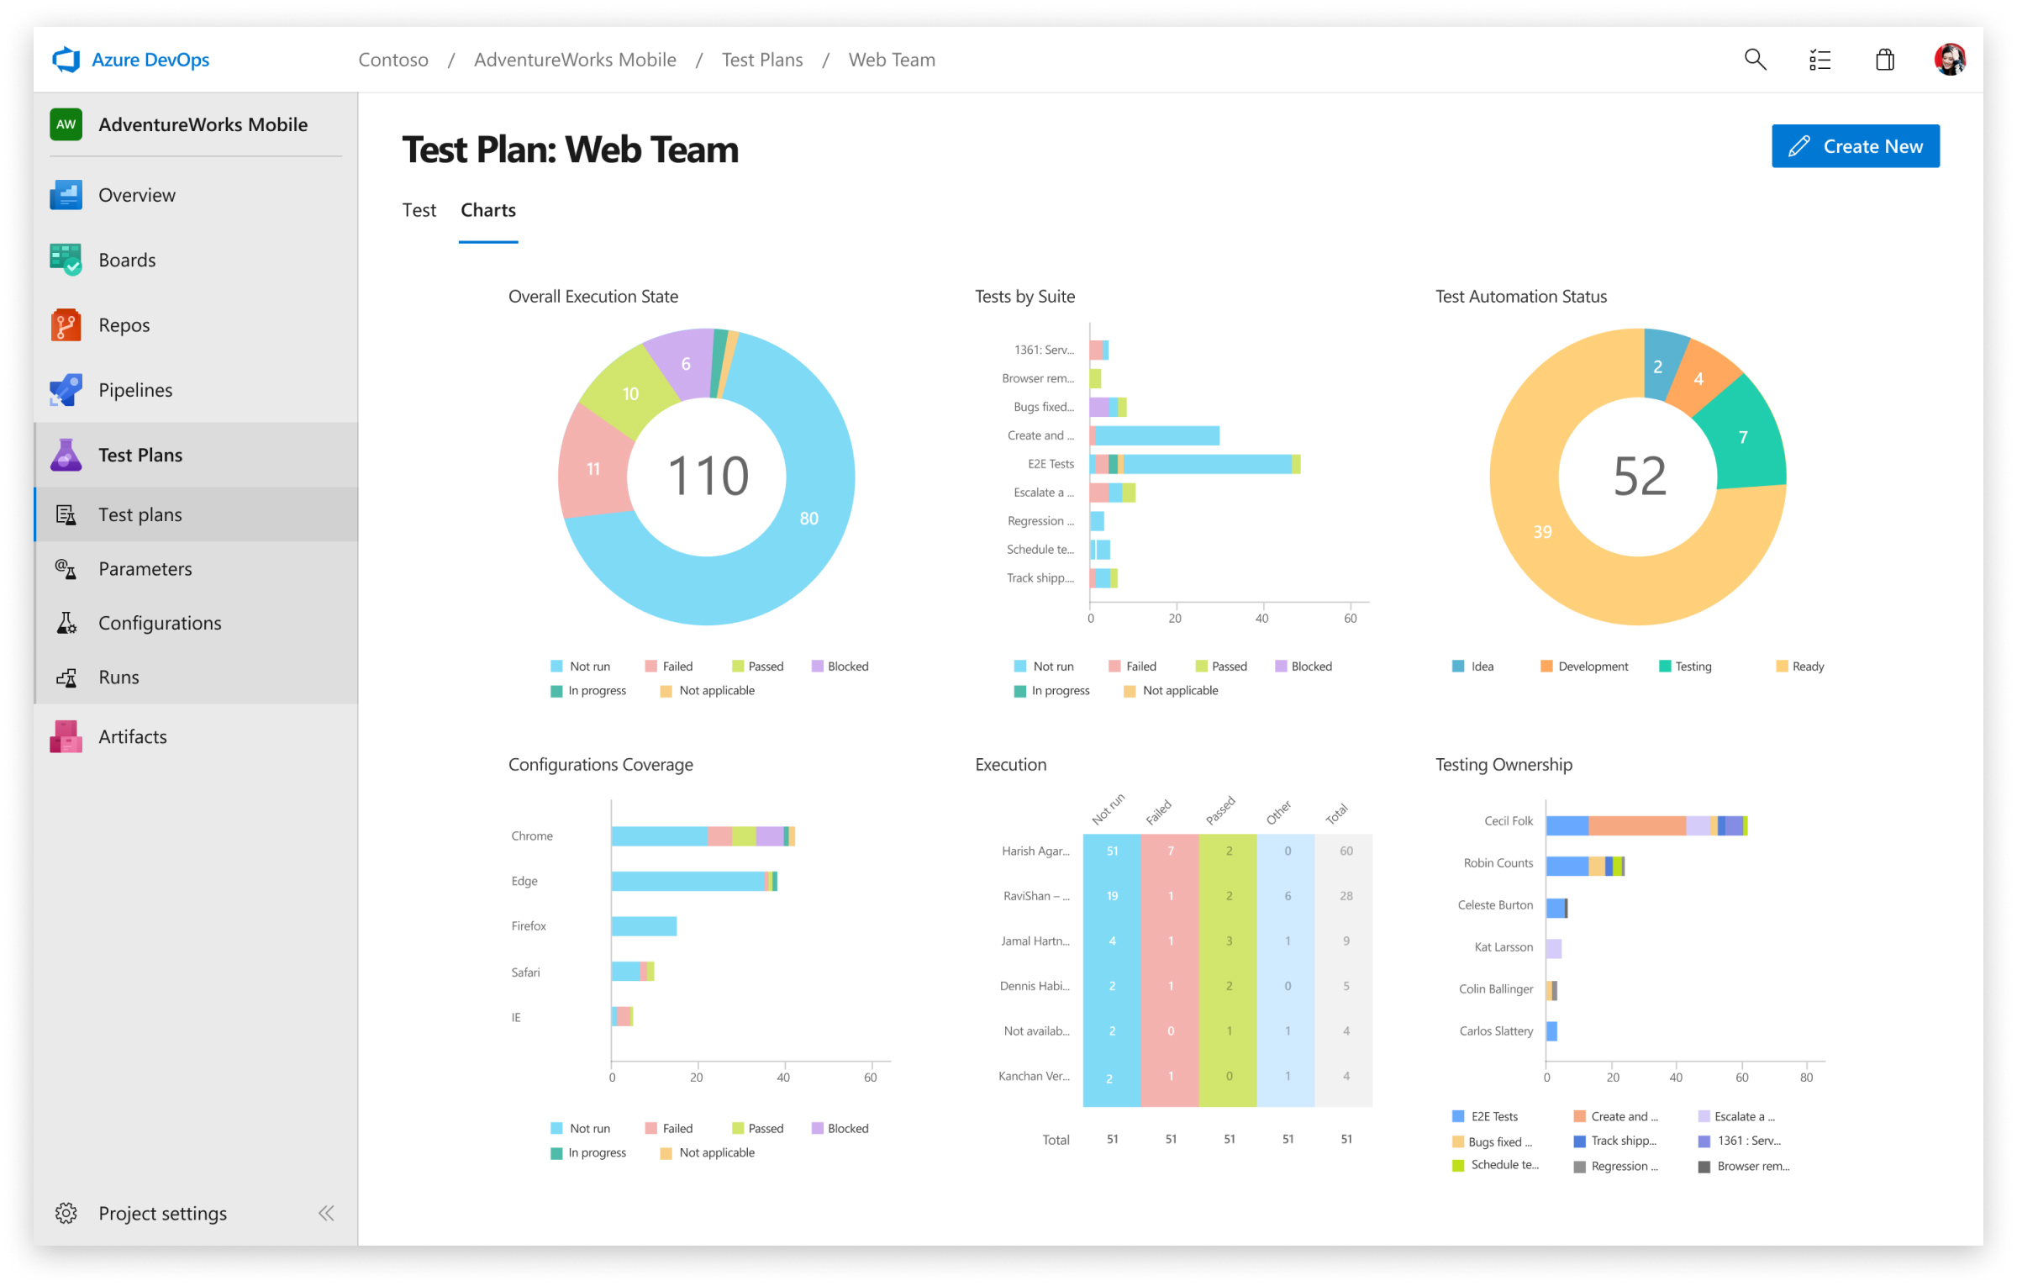
Azure Test Plans
Test and ship with confidence with a testing toolkit

Slide 55
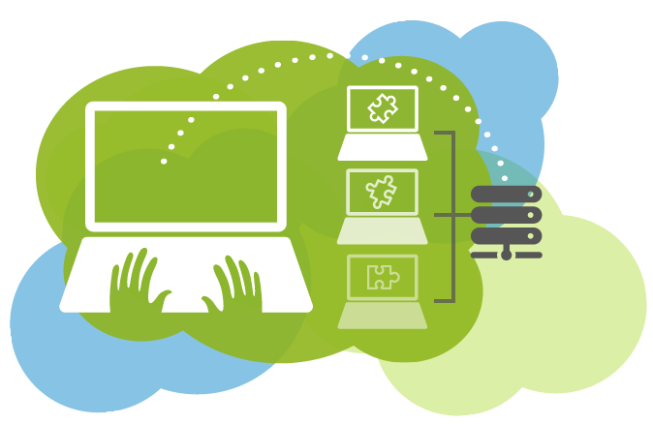
Azure Test Plans
Azure Test Plans – planned and exploratory testing solution
A toolkit for manual and exploratory testing
If you aim for Automation of CI / CD workflow – Azure Pipelines
Azure Test Plans provides many convenient features
Capturing rich data, End-to-End traceability
Testing across web and desktop
Planned manual testing
Exploratory testing

Slide 56
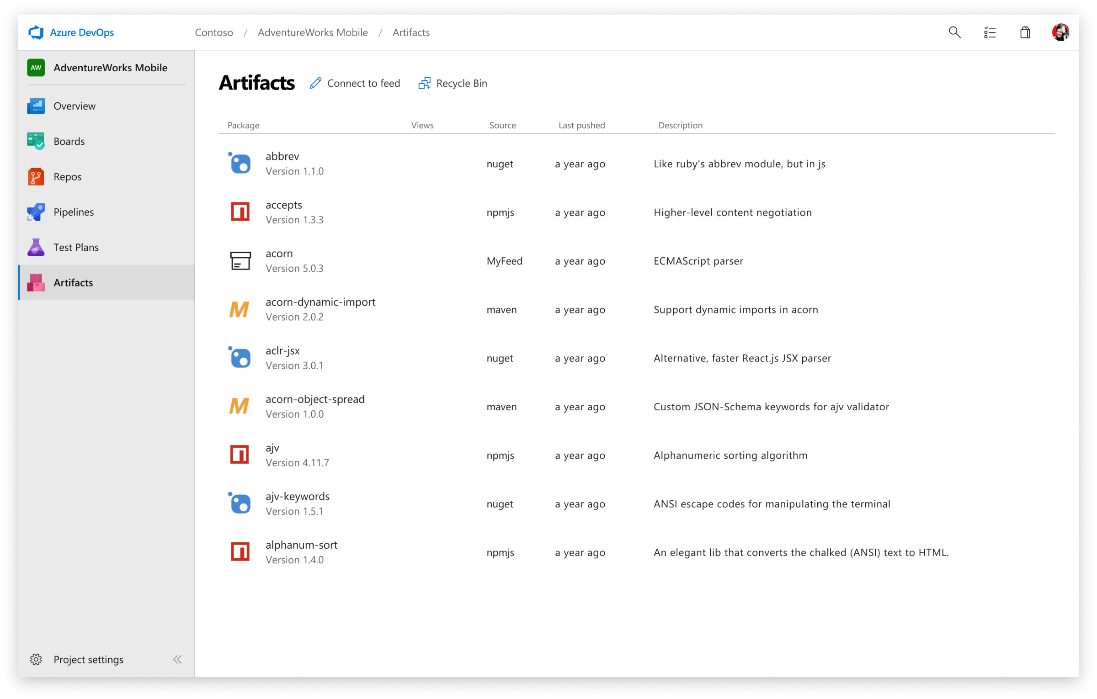
Azure Artifacts
Create, host, and share packages with your team

Slide 57
Azure Artifacts
Azure Artifacts is a package management tool
Create and share packages from Maven, npm, NuGet etc
Provides fully integrated package management for CI / CD
Azure Artifacts includes many features, such as:
Sharing code efficiently, Adding packages to any pipeline
Managing all package types, Protecting packages
Simplifying complex build jobs, Organizing artifacts
Integrating package handling to CI / CD Pipelines

Slide 58
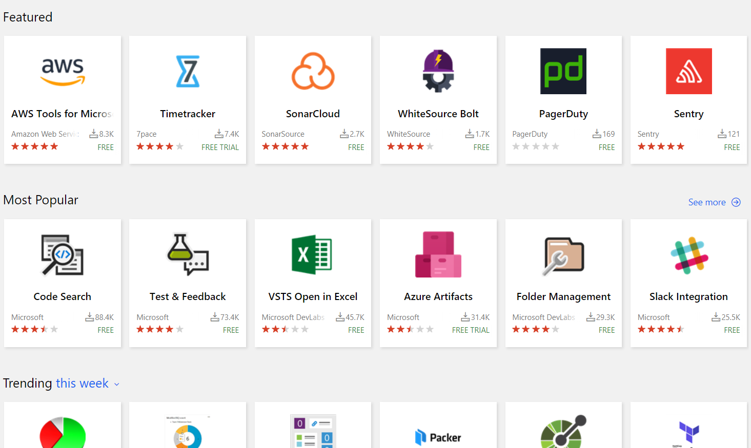
Extensions Marketplace
Extensions for Azure DevOps

Slide 59

Azure App Service
Quickly create powerful cloud apps using a fully managed platform

Slide 60
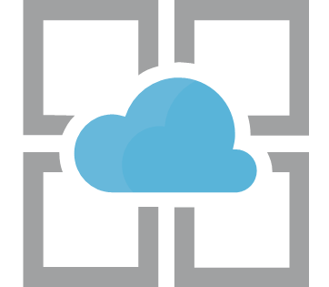
Azure App Service
Azure App Service is a platform for build / host web apps
The applications can be on a technology of any choice
Infrastructure management is non-mandatory
Offers Auto-Scaling, High Availability
Supports both Windows & Linux
Azure App Service offers automated deployment
Deployment can be done from different platforms
GitHub, Azure DevOps, or any Git repo

Slide 61
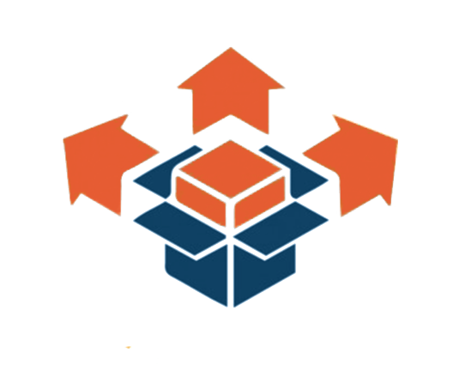

Deployment
Deployment includes all the activities, making a system available for use
Naturally, it is to be referred to as a general process
Most systems have little to nothing in common In terms of business logic
Therefore, every system has its own precise processes and procedures
Deployment activities include:
Configuration, Testing
Installation & Activation
Deactivation & Uninstallation
Release, Deploy, Update, Version Tracking, Adaptation etc...

Slide 62
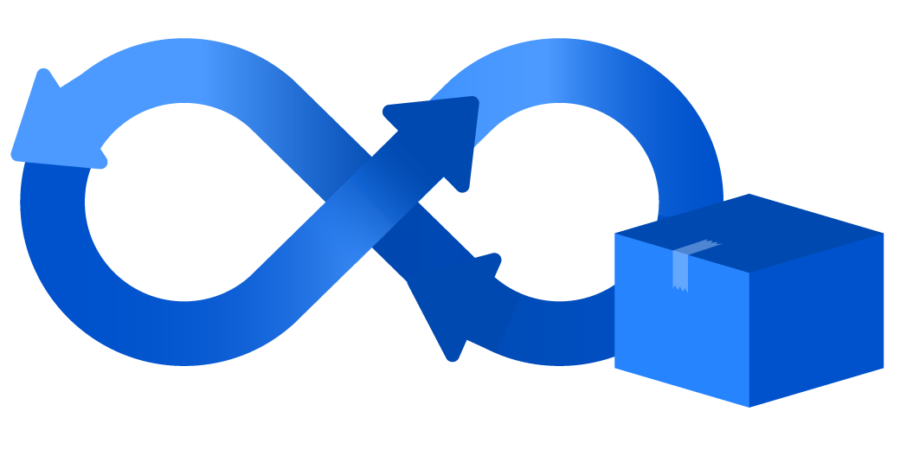
Continuous Integration
Continuous Integration (CI) is the practice of merging working copies
All developer working copies are merged to a shared machine
The process is done as frequently as possible
CI involves integrating early and often
Longer integration spans increase working copy diversity
Eventually the repository becomes different from the baselines
By doing CI, you avoid the pitfalls of the so called "integration hell"
CI aims to reduce rework and thus – optimize cost and time

Slide 63

Azure App Service
Live Demonstration

Slide 64

Summary
Testing
Unit Testing
Integration Testing
Selenium
Selenium Integration
Azure
Azure App Service
Azure DevOps
Azure Insights
Docker
…
…
…

Slide 65
https://softuni.bg/trainings/courses

Slide 66











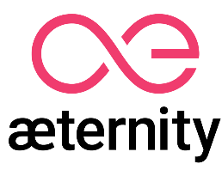

SoftUni Diamond Partners

Slide 67

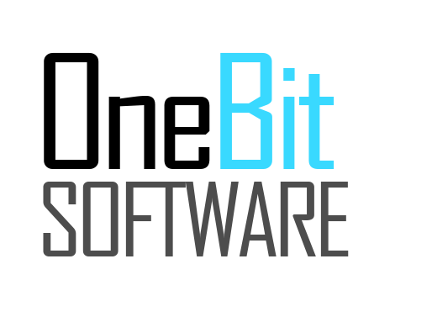



SoftUni Organizational Partners

Slide 68




Trainings @ Software University (SoftUni)
Software University – High-Quality Education and Employment Opportunities
softuni.bg
Software University Foundation
http://softuni.foundation/
Software University @ Facebook
facebook.com/SoftwareUniversity
Software University Forums
forum.softuni.bg

Slide 69

License
This course (slides, examples, demos, videos, homework, etc.) is licensed under the "Creative Commons Attribution-NonCommercial-ShareAlike 4.0 International" license

